Slide 1
Setup
ssh to DAVINCI and grab a GPU node (if you don’t already have one):
$ source /projects/k2i/hpc/scripts/login-gpu.sh
Once you have a GPU node, load the necessary packages and clone today’s Github repo:
$ module load GCCcore/6.4.0 Git/2.17.1
$ source /projects/k2i/hpc/scripts/gpu-day-one-setup.sh
$ git clone https://github.com/agrippa/hpc-bootcamp.git $HOME/bootcamp-gpu
$ module unload Git/2.17.1 GCCcore/6.4.0
It also may be useful to have the CUDA API references open:
http://docs.nvidia.com/cuda/cuda-runtime-api/index.html
Slides are accessible in your browser in Github and Box:
Github: https://github.com/agrippa/hpc-bootcamp Box: http://bit.ly/hpc-bc19

Slide 2
GPU Accelerated Computing (Day 1)
Introduction to Programming GPUs
Max Grossman
Habanero Extreme Scale Software Research Group, Rice University
Principal & Co-Founder, 7pod Technologies
Author, Professional CUDA C Programming

Slide 3
Outline
A Brief History of Computing
GPU Architecture Overview
An Overview of CUDA
Hands-On with a Scientific App
Related Topics:
Alternative GPU Programming Models
Alternatives to GPUs

Slide 4

About Me
Habanero Research Group
Runtime Systems for HPC (“Big Compute”)
Data Analytics (“Big Data”)
Compilers and Programmer Tools
Co-Founder, 7pod Technologies (7pod.tech)
Consulting on new applications of data analytics and high performance computing
HPC and data analytics training

Slide 5
Why GPUs?

Slide 6
Upcoming Hardware Generations
Is your hardware holding you back, or are you holding back your hardware?

Slide 7



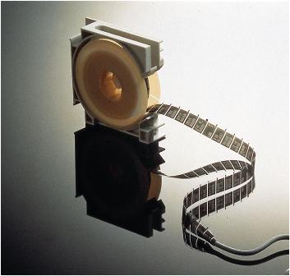
A (Brief) History of Early Personal Computing
1971: Intel 4004
1974: Intel 8080
http://www.computerhope.com/history/processor.htm

Slide 8
A (Brief) History of Early Personal Computing
What do all of these applications have in common?

Slide 9
A (Brief) History of Early Personal Computing
What do all of these applications have in common?
Application performance is entirely dependent on straight-line performance.

Slide 10

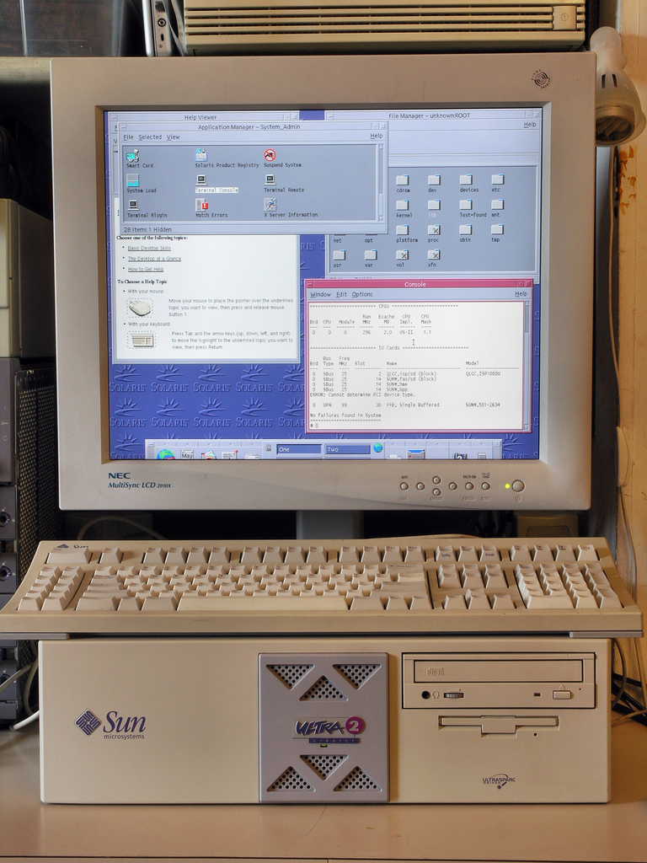
A (Brief) History of Early Personal Computing
First dedicated Graphics Processing Units (GPUs) introduced in the 1990s.

Slide 11
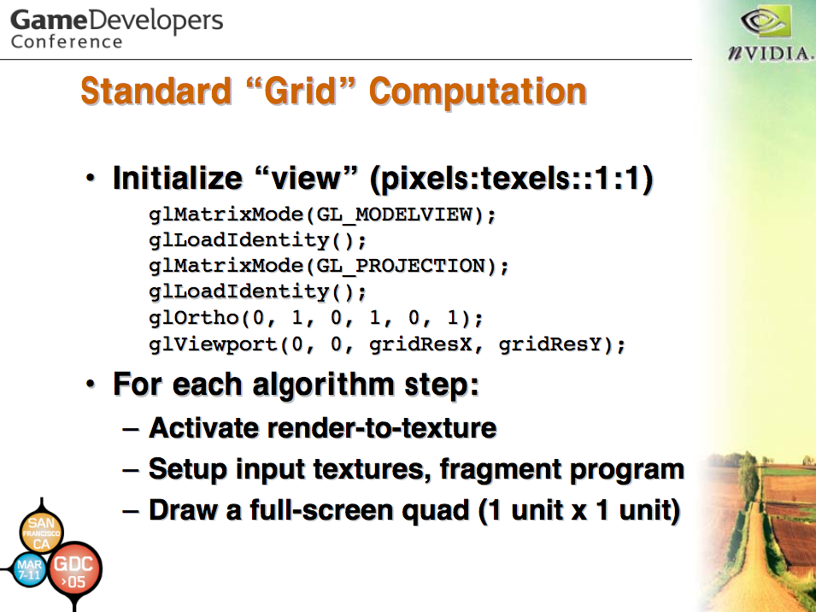
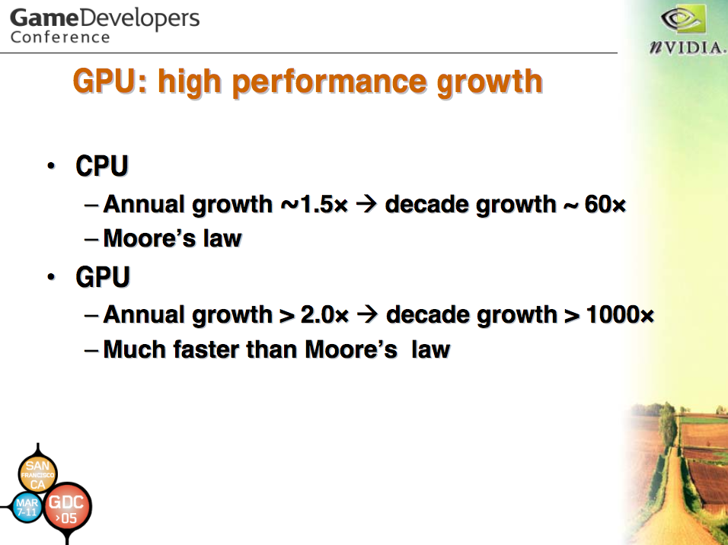
A (Brief) History of Early Personal Computing
Only became programmable in the early 2000s.
ftp://77.67.22.188/developer/presentations/2005/GDC/OpenGL_Day/OpenGL_GPGPU.pdf

Slide 12
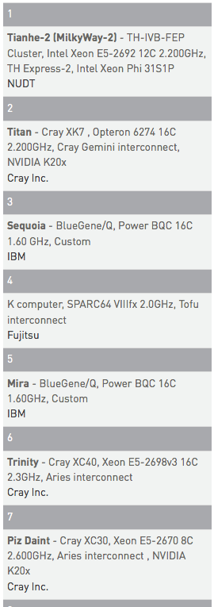
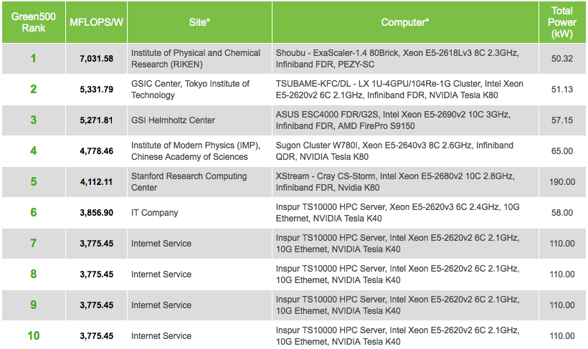
A (Brief) History of Early Personal Computing
And a decade later…
https://www.olcf.ornl.gov/summit/, http://top500.org/, http://www.green500.org/lists/green201511

Slide 13
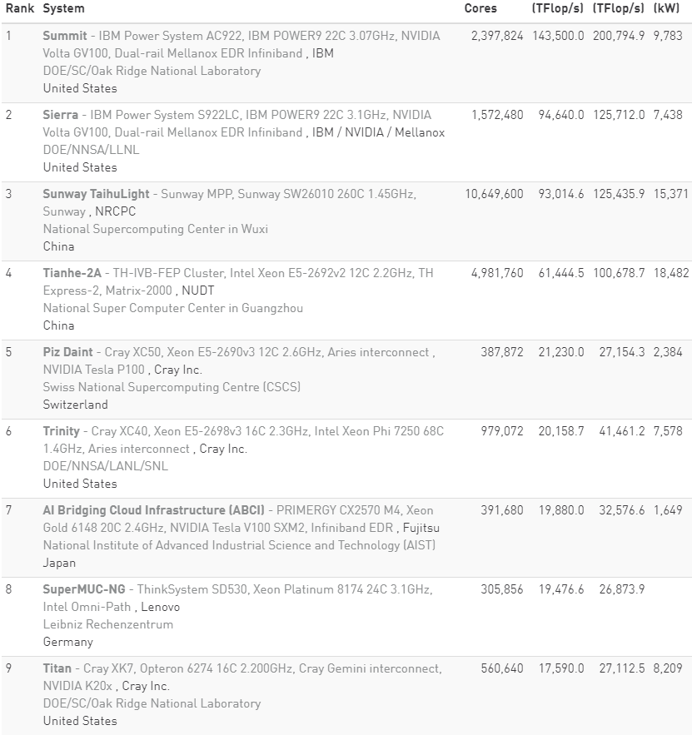
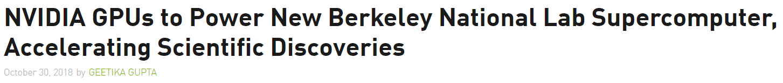

A (Brief) History of Early Personal Computing
Today’s and Tomorrow’s Top 500 list

Slide 14
Latency vs. Throughput in Apps & Datasets
Latency-bound
Throughput-bound
Throughput
Throughput
A
A
B
C
D
Increasing the # of processors doesn’t matter, only straight-line performance.
B
Latency
Latency
Individual processor speed increases matter less than processor count.
C
D
A spectrum, not a discrete distribution
Notes:
Why have GPUs become so popular in HPC? They focus on throughput-bound computing rather than latency-bound computing. Fixed number of transistors on a die, do you spend them on more parallelism or straight line optimizations? When do you start getting diminishing returns?

Slide 15
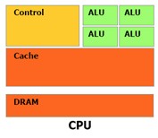
Latency-Optimized Processors
For most consumer (i.e. interactive) applications, latency is the #1 performance metric.
⬆ clock frequencies
⬆ control logic (e.g. branch prediction)
⬆ cache per core
⬇ parallelism/throughput
Notes:
What does a latency-optimized processor (for latency-bound applications) look like?

Slide 16
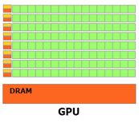
Throughput-Optimized Processors
For many scientific applications, throughput is the #1 performance metric.
⬆ cores/concurrency
⬆ memory bandwidth
⬇ clock frequency
⬇ cache
⬇ control logic
Notes:
What does a throughput-optimized processor (for thoughput-bound applications) look like?

Slide 17
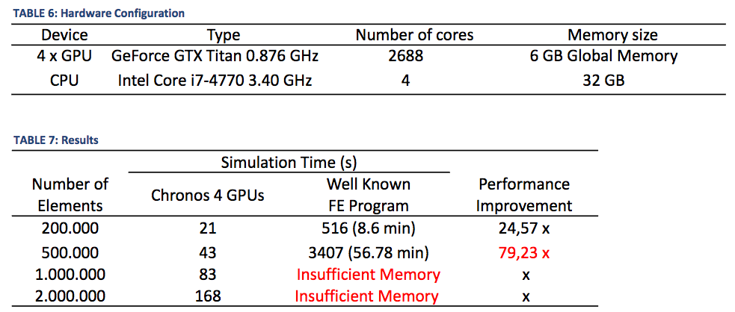
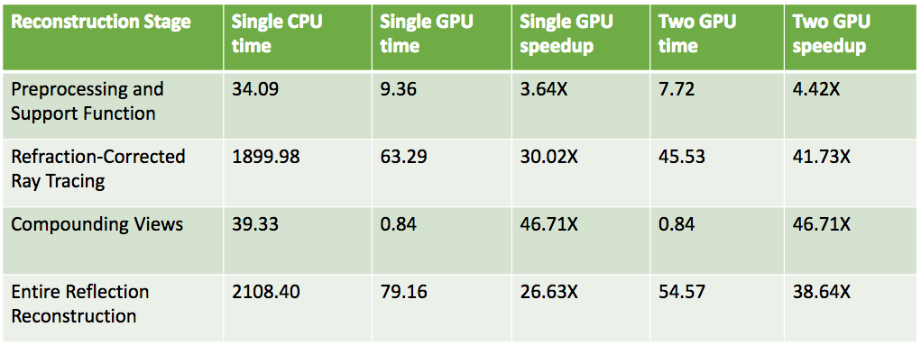
Throughput-Bound Applications
While many applications are latency-bound, the important ones (scientific, finance, medical, etc.) tend to be throughput bound.
“Speeding up a Finite Element Computation on GPU”, GTC 15
“Multi-GPU Accelerated Refraction-Corrected Reflection Image Reconstruction for 3D Ultrasound Breast Imaging”, GTC 15

Slide 18
Overview of (NVIDIA) GPU Architecture

Slide 19
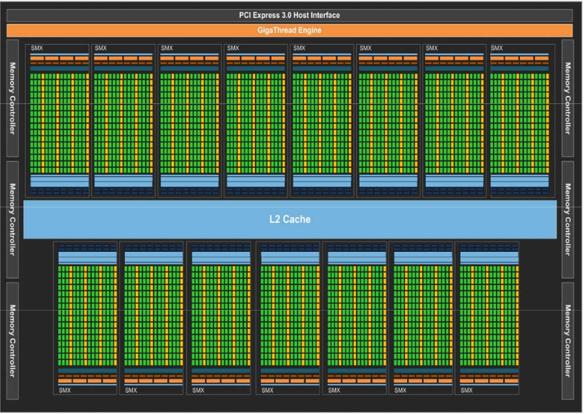
Architectural Generations
Discussion will focus on characteristics shared across architectural generations.
When important, differences between generations will be noted.
Fermi ➔ Kepler ➔ Maxwell ➔ Pascal ➔ Volta
Much of the material in this section can be found in the white papers below.
http://www.nvidia.com/content/pdf/fermi_white_papers/nvidia_fermi_compute_architecture_whitepaper.pdf
https://www.nvidia.com/content/PDF/kepler/NVIDIA-Kepler-GK110-Architecture-Whitepaper.pdf
https://developer.nvidia.com/maxwell-compute-architecture
http://images.nvidia.com/content/pdf/tesla/whitepaper/pascal-architecture-whitepaper.pdf
https://devblogs.nvidia.com/parallelforall/inside-volta/

Slide 20
The CUDA Core
The CUDA Core is the finest granularity of execution on NVIDIA GPUs.
In a single cycle, executes either:
32-bit integer arithmetic instruction
32-bit floating point arithmetic instruction
CUDA core != x86 core.
CUDA Core

Slide 21
The Streaming Multiprocessor (SM)
SM is analogous to “core” in x86 processors
Consists of many CUDA cores
32 for Fermi, 192 for Kepler, 128 for Maxwell, 64 for Pascal
All CUDA cores in the same SM execute in lock step
Registers + on-chip memory are shared among threads running on this SM
Think “vector core” but with more flexibility.
On-Chip Memory
CUDA Core
CUDA Core
LD/ST
SFU
LD/ST
CUDA Core
CUDA Core
LD/ST
SFU
CUDA Core
CUDA Core
LD/ST
LD/ST
SFU
CUDA Core
CUDA Core
LD/ST
Registers

Slide 22
The GPU
Consists of O(10) SMs
L2 cache, device memory (DRAM) shared among all SMs
Off-chip latency ~100x worse than on-chip
L2 Cache
Device Memory

Slide 23
The Full System
CPU
System DRAM
GPUs are not standalone processors, require a CPU to manage them.
Commonly refer to CPU as “host” and GPU as “device”.
Connected by very high latency PCIe bus.
Analogous to two MPI processes, versus OpenMP/Cilk everything shared model.
x86 core
x86 core
x86 core
x86 core
x86 core
x86 core
PCIe bus
GPU
L2 Cache
Device Memory

Slide 24
Hands-On With CUDA, a Simple Example
Notes:
CUDA is a particular programming model for the NVIDIA hardware we just went over.

Slide 25
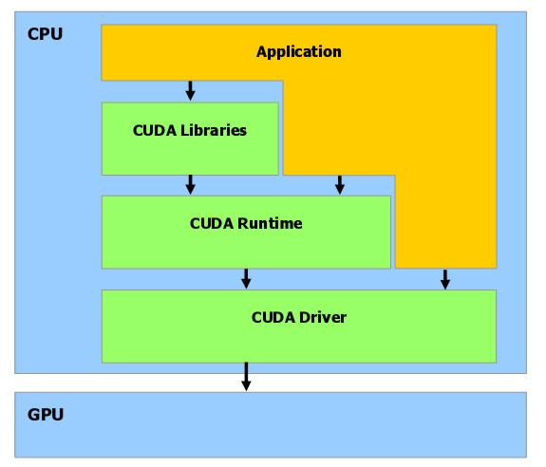
CUDA Software Stack
http://www.comp.leeds.ac.uk/viznet/reports/GPU_report/GPUSTARReport_html.html

Slide 26
A Simple CUDA Example
Kernel is written as single-threaded code.
A single CUDA thread per CUDA core, each CUDA thread executes same kernel (similar to SPMD).
Let’s start by considering vector addition: C = B + A
void vector_add(int *C, int *B, int *A, int N) {
int i;
for (i = 0; i < N; i++) {
C[i] = A[i] + B[i];
} }
CUDA Core

Slide 27
A Simple CUDA Example
To enable GPU execution of this function, simply add __global__:
__global__ void vector_add(int *C, int *B, int *A,
int N) {
int i;
for (i = 0; i < N; i++) {
C[i] = A[i] + B[i];
} }
CUDA Core

Slide 28
A Simple CUDA Example
CUDA function type qualifiers:
Qualifier | Executes on… | Callable from…
__global__ | device | host
__host__ | host | host
__device__ | device | device
CUDA Core
__device__ void bar(...) { ... }
__global__ void foo(...) {
bar(...);
}

Slide 29
A Simple CUDA Example
Calling this kernel from the host requires special syntax to indicate that the function call runs on the device:
__global__ void vector_add(...) {
...
}
vector_add<<<1, 1>>>(C, A, B, N);
Host
Kernel offload
Device
Run one thread on the GPU (more on this later)

Slide 30
A Simple CUDA Example
One final step: the data.
Recall that host and device are physically discrete processors ➔ separate address spaces, a pointer on one has no meaning on the other.
Host
int *A = (int *)malloc(N * sizeof(int));
int *B = (int *)malloc(N * sizeof(int));
int *C = (int *)malloc(N * sizeof(int));
vector_add<<<1, 1>>>(C, A, B, N);
Device
__global__ void vector_add(int *C,
int *A, int *B, int N) {
int i;
for (i = 0; i < N; i++) {
C[i] = A[i] + B[i];
} }

Slide 31
A Simple CUDA Example
Host
int *A = (int *)malloc(N * sizeof(int));
int *B = (int *)malloc(N * sizeof(int));
int *C = (int *)malloc(N * sizeof(int));
vector_add<<<1, 1>>>(C, A, B, N);
Device
__global__ void vector_add(int *C,
int *A, int *B, int N) {
int i;
for (i = 0; i < N; i++) {
C[i] = A[i] + B[i];
} }
✗
✗
✔
✗
✔
✔
Host
Device
PCIe

Slide 32
A Simple CUDA Example
Host
int *A = (int *)malloc(N * sizeof(int));
int *B = (int *)malloc(N * sizeof(int));
int *C = (int *)malloc(N * sizeof(int));
vector_add<<<1, 1>>>(C, A, B, N);
Device
__global__ void vector_add(int *C,
int *A, int *B, int N) {
int i;
for (i = 0; i < N; i++) {
C[i] = A[i] + B[i];
} }
✔
✔
✔
Host
Device
PCIe

Slide 33
A Simple CUDA Example
cudaError_t cudaMalloc(void **devPtr, size_t size);
Allocate size bytes of memory on GPU.
Store address at *devPtr.
Host
int *A = (int *)malloc(N * sizeof(int));
int *B = (int *)malloc(N * sizeof(int));
int *C = (int *)malloc(N * sizeof(int));
vector_add<<<1, 1>>>(C, A, B, N);
Device
__global__ void vector_add(int *C,
int *A, int *B, int N) {
int i;
for (i = 0; i < N; i++) {
C[i] = A[i] + B[i];
} }
✔
✔
✔
Host
Device
PCIe

Slide 34
A Simple CUDA Example
Host
int *A = (int *)malloc(N * sizeof(int));
int *B = (int *)malloc(N * sizeof(int));
int *C = (int *)malloc(N * sizeof(int));
vector_add<<<1, 1>>>(C, A, B, N);
Device
__global__ void vector_add(int *C,
int *A, int *B, int N) {
int i;
for (i = 0; i < N; i++) {
C[i] = A[i] + B[i];
} }
✔
✔
✔
Host
Device
PCIe

Slide 35
A Simple CUDA Example
cudaError_t cudaMemcpy(void *dst, const void *src,
size_t size, enum cudaMemcpyKind direction);
Transfer size bytes from src to dst.
Address spaces must obey direction, can be:
cudaMemcpyHostToHost
cudaMemcpyDeviceToDevice
cudaMemcpyHostToDevice
cudaMemcpyDeviceToHost
Host
int *A = (int *)malloc(N * sizeof(int));
int *B = (int *)malloc(N * sizeof(int));
int *C = (int *)malloc(N * sizeof(int));
vector_add<<<1, 1>>>(C, A, B, N);
Device
__global__ void vector_add(int *C,
int *A, int *B, int N) {
int i;
for (i = 0; i < N; i++) {
C[i] = A[i] + B[i];
} }
✔
✔
✔
Host
Device
PCIe

Slide 36
A Simple CUDA Example
Host
int *A = (int *)malloc(N * sizeof(int));
int *B = (int *)malloc(N * sizeof(int));
int *C = (int *)malloc(N * sizeof(int));
vector_add<<<1, 1>>>(C, A, B, N);
Device
__global__ void vector_add(int *C,
int *A, int *B, int N) {
int i;
for (i = 0; i < N; i++) {
C[i] = A[i] + B[i];
} }
✔
✔
✔
✔
✔
✔
Host
Device
PCIe

Slide 37
A Simple CUDA Example
int *A, *d_A;
A = (int *)malloc(N * sizeof(int));
cudaMalloc((void **)&d_A, N * sizeof(int));
cudaMemcpy(d_A, A, N * sizeof(int), cudaMemcpyHostToDevice);
...
vector_add<<<1, 1>>>(d_C, d_A, d_B, N);
Host
cudaError_t cudaMalloc(void **devPtr, size_t size);
cudaError_t cudaMemcpy(void *dst, const void *src,
size_t size, enum cudaMemcpyKind direction);
cudaError_t cudaFree(void *addr);
Device

Slide 38
A Simple CUDA Example
Building CUDA programs requires nvcc. Supports all of the usual flags you expect from a compiler.
$ cd ~/bootcamp-gpu/src/00_vecadd
$ nvcc –arch=sm_20 vecadd.cu –o vecadd
*Makefiles will be provided for your convenience
NVIDIA’s GPU compiler
Compile and optimize for the Fermi architecture
Input CUDA file
Output executable

Slide 39
Hands On - 00_vecadd
Don’t forget to follow the instructions on slide 1.
$ cd ~/bootcamp-gpu/src/00_vecadd
$ make
$ vim/emacs vecadd.cu # Get familiar with the code
$ ./vecadd 131072 # Vectors with 131,072 elements
What kind of performance do you observe?
Does it change relatively with different input sizes?
$ git clone git@github.com:agrippa/hpc-bootcamp.git $HOME/bootcamp-gpu

Slide 40
Hands On - 00_vecadd

Slide 41
Review - Basic CUDA
Running a function on the GPU requires 1) __global__ annotation, and 2) kernel launch syntax (<<<...>>>).
CUDA forces you to think about discrete address spaces and manage coherency.
Copying and pasting code is not the path to performance in CUDA.
cudaError_t cudaMalloc(void **devPtr, size_t size);
cudaError_t cudaMemcpy(void *dst, const void *src,
size_t size, enum cudaMemcpyKind direction);
cudaError_t cudaFree(void *addr);

Slide 42
nvprof
nvprof is a command-line profiler for CUDA applications.
$ nvprof --help
Usage: nvprof [options] [CUDA-application] [application-arguments]
...
Can be used in a number of modes:
Default/Summary Mode
API Trace Mode
Event/Metric Summary Mode
Event/Metric Trace Mode
http://docs.nvidia.com/cuda/profiler-users-guide/

Slide 43
Hands On – nvprof Summary mode
A good starting point is usually Default/Summary mode.
$ nvprof ./vecadd 131072
http://docs.nvidia.com/cuda/profiler-users-guide/

Slide 44
Hands On – nvprof Summary mode
A good starting point is usually Default/Summary mode.
$ nvprof ./vecadd 131072
==17036== NVPROF is profiling process 17036, command: ./vecadd 131072
Finished! All 131072 elements validate.
Took 621 microseconds on the host
Took 19725 microseconds on the device, 0.03148x speedup
==17036== Profiling application: ./vecadd 131072
==17036== Profiling result:
Time(%) Time Calls Avg Min Max Name
98.61% 18.656ms 1 18.656ms 18.656ms 18.656ms vector_add(int*, int*, int*, int)
0.95% 180.03us 2 90.015us 89.951us 90.079us [CUDA memcpy HtoD]
0.44% 82.655us 1 82.655us 82.655us 82.655us [CUDA memcpy DtoH]
http://docs.nvidia.com/cuda/profiler-users-guide/

Slide 45
nvprof
Diving deeper requires Event/Metric Summary Mode.
$ nvprof --query-events # List all enabled events
$ nvprof --query-metrics # List all enabled metrics
Events are raw data collected by the hardware, e.g. # instructions (inst_issued)
Metrics are derived based on events, e.g. # instructions per cycle (issued_ipc)

Slide 46
Hands On – nvprof Metrics
Diving deeper requires Event/Metric Summary Mode.
ipc: # of instructions executed per cycle on the GPU
sm_efficiency: % of time an SM on the GPU is doing useful work
alu_fu_utilization: indicates how well the CUDA cores are being used
$ nvprof --metrics ipc,sm_efficiency,alu_fu_utilization ./vecadd 131072

Slide 47
Hands On – nvprof Metrics
Diving deeper requires Event/Metric Summary Mode.
$ nvprof --metrics ipc,sm_efficiency,alu_fu_utilization ./vecadd 131072
==30413== Warning: Some kernel(s) will be replayed on device 0 in order to collect all events/metrics.
Finished! All 131072 elements validate.
Took 621 microseconds on the host
Took 174666 microseconds on the device, 0.00356x speedup
==30413== Profiling application: ./vecadd 131072
==30413== Profiling result:
==30413== Metric result:
Invocations Metric Name Metric Description Min ...
Device "Tesla M2050 (0)"
Kernel: vector_add(int*, int*, int*, int)
1 sm_efficiency Multiprocessor Activity 7.14% ...
1 ipc Executed IPC 0.103982 ...
1 alu_fu_utilization Arithmetic Function Unit Utilization Low (1) ...

Slide 48
nvprof

Slide 49
CUDA Execution Model
Or How to Write Parallel CUDA Programs
Notes:
CUDA is a particular programming model for the NVIDIA hardware we just went over.

Slide 50
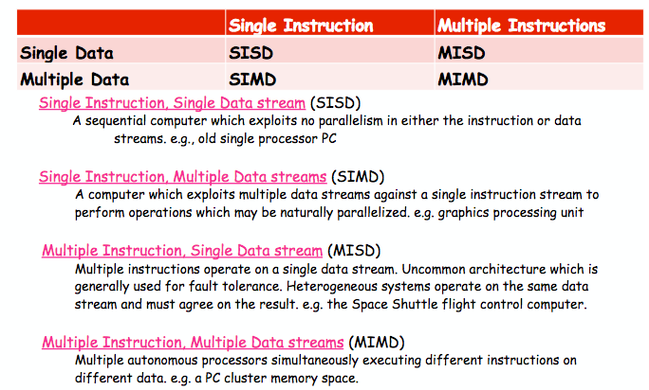
Flynn’s Taxonomy
Prof. Vivek Sarkar, Rice University, COMP 322

Slide 51
CUDA Execution Model
Recall:
Programmer writes single-threaded kernel
1 CUDA thread per CUDA core.
CUDA Core

Slide 52
CUDA Execution Model
Recall:
Programmer writes single-threaded kernel
1 CUDA thread per CUDA core.
Threads are scheduled in groups of 32, called a warp.
Warps execute in lock step (same instruction at same cycle)
All threads in warp on same SM

Slide 53
CUDA Execution Model
Recall:
Programmer writes single-threaded kernel
1 CUDA thread per CUDA core.
Threads are scheduled in groups of 32, called a warp.
Warps are grouped into thread blocks.
Warps in a block execute on same SM
Warp execution in same thread block can be interleaved with each other on SM
SM resources are partitioned among all threads in resident thread blocks
e.g. 4 warps in one thread block

Slide 54
CUDA Execution Model
vector_add<<<...>>>(...)
Recall:
Programmer writes single-threaded kernel
1 CUDA thread per CUDA core.
Threads are scheduled in groups of 32, called a warp.
Warps are grouped into thread blocks.
A single kernel grid can include many thread blocks.
Kernel call is not complete until all thread blocks within it complete.
Block₀
Block₁
Block₂
Block₃

Slide 55
CUDA Execution Model
Blocks and grids are configurable by kernel launch arguments:
vector_add<<<nblocks, nthreads_per_block>>>(...)
vector_add<<<1, 1>>>(...); // 1 block with 1 thread inside it
vector_add<<<1, 32>>>(...); // 1 block with 1 full warp
vector_add<<<1, 256>>>(...); // 1 block with 256 threads (8 warps)
vector_add<<<N, 256>>>(...); // N blocks with 256 threads/block

Slide 56
CUDA Execution Model
Blocks and grids can also be multi-dimensional:
// Equivalent to vector_add<<<1, 256>>>(...);
dim3 1d_block(256, 1, 1);
vector_add<<<1, 1d_block>>>(...);
dim3 block(16, 16); // 2D 16x16 block of threads, 256 total
dim3 grid(4, 4); // 2D 4x4 grid of thread blocks, 16 total
kernel<<<grid, block>>>(...);

Slide 57
CUDA Execution Model
Special CUDA kernel variables can be used to check the coordinates of a thread in an executing grid.
Variable Name | Description
threadIdx.x, threadIdx.y, … | Offset of a thread within a thread block
blockIdx.x, blockIdx.y, … | Offset of a block within a grid
blockDim.x, … | # of threads per block
gridDim.x, … | # of blocks in grid
blockIdx.x * blockDim.x + threadIdx.x | One way to calculate globally unique thread ID for 1D blocks and grids

Slide 58
CUDA Execution Model
__global__ void matrix_add(...) {
const int row = blockIdx.x * blockDim.x + threadIdx.x;
const int col = blockIdx.y * blockDim.y + threadIdx.y;
...
}
dim3 block(8, 8); // 2D 8x8 block of threads, 64 total
dim3 grid(2, 2); // 2D 2x2 grid of thread blocks, 4 total
vector_add<<<grid, block>>>(...);

Slide 59
CUDA Execution Model
Block (0, 0)
Block (0, 1)
Block (1, 0)
Block (1, 1)

Slide 60
CUDA Execution Model
Launch configuration alone is insufficient for our vector_add to run in parallel.
vector_add<<<N / 256, 256>>>(C, A, B, N);
[0,N)
[0,N)
[0,N)
[0,N)
[0,N)
[0,N)
[0,N)
[0,N)
T₀
T₁
T₂
T₃
T₄
T₅
T₆
T₇

Slide 61
CUDA Execution Model
Must also change the work performed by the kernel.
__global__ void vector_add(int *C, int *B, int *A, int N) {
const int i = blockIdx.x * blockDim.x + threadIdx.x;
C[i] = A[i] + B[i];
}
0
1
2
3
4
5
6
7
T₀
T₁
T₂
T₃
T₄
T₅
T₆
T₇

Slide 62
Hands On – Adding CUDA Parallelism
Using the previous slides as a guide, add parallelism to the vecadd example:
Change the <<<...>>> launch configuration to use B threads per block, N/B blocks
Be careful that the N you run is evenly divisible by B
CUDA supports up to 1,024 threads per block
Change the kernel to process a single data point
Does performance improve?
$ ./vecadd 1048576
Does block size affect performance?

Slide 63
Hands On – Adding CUDA Parallelism
More similar host and device performance (was ~150,000 us).
No clear trends in performance as a function of block size (yet).
Still not great performance, time to go back to nvprof.

Slide 64
Hands On – Adding CUDA Parallelism
$HOME/bootcamp-gpu/src/01_vecadd contains an example solution that allows configuring threads per block from the command line:
$ cd $HOME/bootcamp-gpu/src/01_vecadd
$ ./vecadd <N> <threads-per-block>
Try:
$ nvprof --metrics ipc,sm_efficiency,alu_fu_utilization \
./vecadd 1048576 256
$ nvprof ./vecadd 1048576 256

Slide 65
Hands On – Adding CUDA Parallelism
$ nvprof --metrics ipc,sm_efficiency,alu_fu_utilization ./vecadd 1048576
==32216== NVPROF is profiling process 32216, command: ./vecadd 1048576
==32216== Warning: Some kernel(s) will be replayed on device 0 in order to collect all events/metrics.
Finished! All 1048576 elements validate using 256 threads per block.
Took 5032 microseconds on the host
Took 21110 microseconds on the device, 0.23837x speedup
==32216== Profiling application: ./vecadd 1048576
==32216== Profiling result:
==32216== Metric result:
Invocations Metric Name Metric Description Min
Device "Tesla M2050 (0)"
Kernel: vector_add(int*, int*, int*, int)
1 sm_efficiency Multiprocessor Activity 96.20% …
1 ipc Executed IPC 0.657917 …
1 alu_fu_utilization Arithmetic Function Unit Utilization Low (3) …
0.103982
7.14 %
Low (1)

Slide 66
Hands On – Adding CUDA Parallelism
$ nvprof ./vecadd 1048576 256
[jmg3@gpu-014 01_vecadd]$ /opt/apps/software/Compiler/GCC/4.4.7/CUDA/6.5.14/bin/nvprof ./vecadd 1048576 32
==32199== NVPROF is profiling process 32199, command: ./vecadd 1048576 32
Finished! All 1048576 elements validate using 32 threads per block.
Took 5049 microseconds on the host
Took 4541 microseconds on the device, 1.11187x speedup
==32199== Profiling application: ./vecadd 1048576 32
==32199== Profiling result:
Time(%) Time Calls Avg Min Max Name
44.85% 1.5758ms 1 1.5758ms 1.5758ms 1.5758ms [CUDA memcpy DtoH]
43.93% 1.5436ms 2 771.81us 767.70us 775.93us [CUDA memcpy HtoD]
10.26% 360.38us 1 360.38us 360.38us 360.38us vector_add(int*, int*, int*, int)
0.96% 33.856us 1 33.856us 33.856us 33.856us [CUDA memset]

Slide 67
Review – CUDA Execution Model
nvcc – Compile CUDA applications, shares many flags with x86 compilers, use -arch to target specific GPU generations.
nvprof – Tool for analyzing CUDA applications, profile-driven optimization!
CUDA thread hierarchy: thread, warp, thread block, and grid
Access thread coordinates from running kernel via blockIdx.x, threadIdx.x, blockDim.x
Good to maximize parallelism of CUDA kernels over input, PCIe transfers can quickly become bottlenecks

Slide 68
CUDA Asynchronous Execution
Notes:
CUDA is a particular programming model for the NVIDIA hardware we just went over.

Slide 69
CUDA Asynchronous Execution
Most APIs are synchronous by default.
When you call malloc, you expect its return value to point to immediately addressable memory.
Commonly, high latency operations support some level of asynchrony:
POSIX AIO
NodeJS/Javascript callbacks
E-mail
Overlapping useful work on-core with asynchronous work off-core can benefit performance.

Slide 70
CUDA Asynchronous Execution
CUDA supports both blocking and asynchronous APIs.
A kernel launch <<<...>>> is asynchronous. A cudaMemcpy is blocking.
Host thread
Host thread
Kernel launch
cudaMemcpy
Return only when data is on GPU
Return immediately
GPU
GPU

Slide 71
CUDA Asynchronous Execution
Some blocking APIs have asynchronous equivalents. Some don’t.
Blocking API | Asynchronous API
cudaMalloc
cudaMemcpy | cudaMemcpyAsync
 | Kernel launch (<<<...>>>)
cudaFree

Slide 72
CUDA Asynchronous Execution
The core of CUDA asynchrony is CUDA streams.
A CUDA stream defines a sequence of CUDA operations (e.g. kernel launch, memory copy, etc.) to be performed in order.
CPU
GPU
OP₂
OP₁
OP₀

Slide 73
CUDA Asynchronous Execution
Streams must be explicitly created by the programmer:
cudaStream_t stream;
cudaError_t cudaStreamCreate(cudaStream_t *stream);
cudaError_t cudaStreamDestroy(cudaStream_t *stream);

Slide 74
CUDA Asynchronous Execution
Every asynchronous operation is associated with a CUDA stream.
If the CUDA stream is not explicitly set, a default stream is used.
Implicit default stream
kernel<<<...>>>(...);
cudaMemcpyAsync(...);
Explicit stream
kernel<<<..., stream>>>(...);
cudaMemcpyAsync(..., stream);

Slide 75
CUDA Asynchronous Execution
Stream status can be queried or blocked on.
Implicitly includes all past operations in that stream.
cudaStream_t stream;
cudaStreamCreate(&stream);
kernel<<<..., stream>>>(...);
cudaStreamSynchronize(stream);
cudaError_t cudaStreamSynchronize(cudaStream_t stream);
cudaError_t cudaStreamQuery(cudaStream_t stream);

Slide 76
CUDA Asynchronous Execution
kernel1<<<..., stream>>>(...);
kernel2<<<..., stream>>>(...);
kernel3<<<..., stream>>>(...);
cudaStreamSynchronize(stream);
Host thread
kernel1
kernel2
kernel3
Synchronize
kernel1
kernel2
kernel1

Slide 77
CUDA Asynchronous Execution
Also possible to query specific points in time within a stream using CUDA Events.
Events are inserted in to streams and satisfied as they exit the stream.
Enable querying of all operations inserted in to the stream prior to the event.
CPU
GPU
OP₂
OP₁
OP₀
event

Slide 78
CUDA Asynchronous Execution
Like streams, events can be created, destroyed, queried, and blocked on.
Placing an event in a stream:
cudaEvent_t event;
cudaError_t cudaEventCreate(cudaEvent_t *event,
unsigned int flags);
cudaError_t cudaEventDestroy(cudaEvent_t event);
cudaError_t cudaEventQuery(cudaEvent_t event);
cudaError_t cudaEventSynchronize(cudaEvent_t event);
cudaError_t cudaEventRecord(cudaEvent_t event,
cudaStream_t stream);

Slide 79
CUDA Asynchronous Execution
Synchronizing on all operations issued to a given device is possible with cudaDeviceSynchronize.
cudaError_t cudaDeviceSynchronize();
CPU
GPU
OP₂
OP₁
OP₀
OP₅
OP₄
OP₃

Slide 80
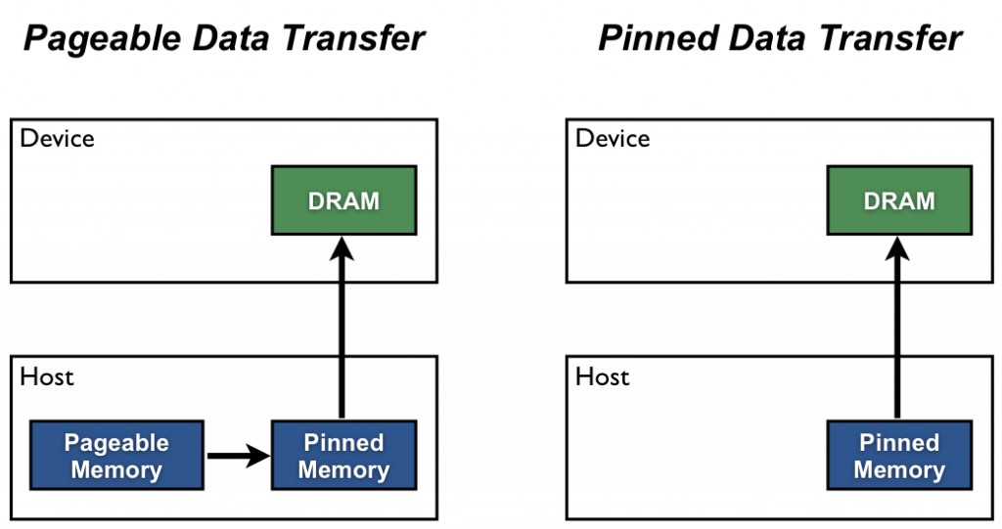
Special Note on cudaMemcpyAsync
Host allocations transferred through cudaMemcpyAsync must be page-locked/pinned.
CUDA provides cudaMallocHost for page-locked host allocations.
cudaError_t cudaMallocHost(void **ptr, size_t size);
https://devblogs.nvidia.com/parallelforall/how-optimize-data-transfers-cuda-cc/

Slide 81
CUDA Asynchronous Execution
$HOME/bootcamp-gpu/src/02_vecadd_streams/vecadd.cu contains an example of chunked, synchronous vector addition.
$ ./vecadd <N> <nchunks>
+
+
+
+
=
=
=
=

Slide 82
Hands On – CUDA Streams
Complete the template in $HOME/bootcamp-gpu/src/02_vecadd_streams/vecadd.cu based on the TODOs contained to use a different stream on each vector chunk.
$ ./vecadd 4194304 4 # Vector of 4,194,304 elements, 4 chunks
Do multiple streams significantly improve performance for this example?
Stream 0
Stream 1
Stream 2
Stream 3
+
+
+
+
=
=
=
=

Slide 83
Hands On – CUDA Streams
Try using nvprof’s GPU tracing mode to understand stream interleaving.
$ nvprof --print-gpu-trace ./vecadd_solution 4194304 1
$ nvprof --print-gpu-trace ./vecadd_solution 4194304 4

Slide 84
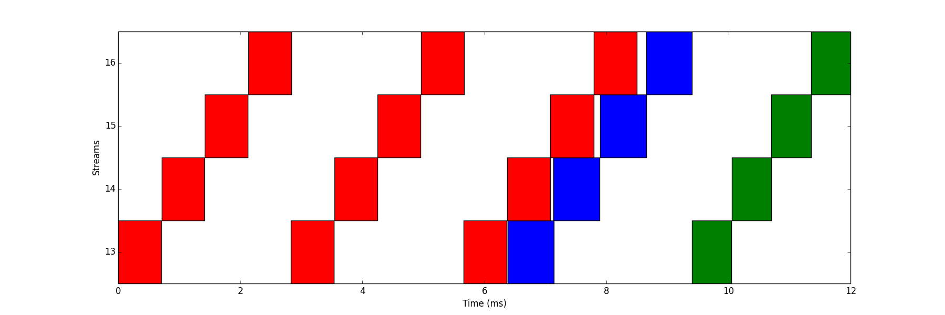
Hands On – CUDA Streams
Copy to device
Kernel
Copy to host

Slide 85
Review – CUDA Asynchrony
A CUDA stream defines a sequence of CUDA operations (e.g. kernel launch, memory copy, etc.) to be performed in order.
CUDA events are inserted in to streams and satisfied as they exit the stream, mark a specific point-in-time in the processing of the operations in that stream.
Using asynchronous APIs requires an understanding of streams (and events), can benefit performance by enabling host-device, host-copy, device-copy overlaps.
cudaStreamCreate, cudaStreamDestroy, cudaStreamSynchronize, cudaStreamQuery, cudaEventCreate, cudaEventDestroy, cudaEventQuery, cudaEventSynchronize, cudaEventRecord, cudaDeviceSynchronize, cudaMallocHost

Slide 86
CUDA Memory Hierarchy
Notes:
CUDA is a particular programming model for the NVIDIA hardware we just went over.

Slide 87
Memory Hierarchies
Up until now, we’ve glossed over efficient data access in CUDA kernels.
On CPU, this generally involves optimizing for cache line locality.
A memory hierarchy emulates a large amount of low-latency memory
DRAM
L2 Cache
L1 Cache

Slide 88
CUDA Memory Hierarchy
CUDA Grid
The CUDA Memory Hierarchy is more complex than the CPU’s
Many different types of memory, each with special-purpose characteristics
More explicit control over data movement
CUDA Thread Block
CUDA Threads/Warp
Registers
Local Memory
Shared Memory
L1 Cache
L2 Cache
Global Memory
Constant Memory
Texture Memory

Slide 89
CUDA Memory Hierarchy
Registers
Lowest latency memory space on the GPU
Private to each CUDA thread
Constant pool of registers per-SM divided among threads in resident thread blocks
Architecture-dependent limit on number of registers per thread
Registers are not explicitly used by the programmer, implicitly allocated by the compiler
nvcc –maxrregcount allows you to limit # registers per thread

Slide 90
CUDA Memory Hierarchy
Local Memory
When registers are exhausted, variables spill to local memory
Variables likely to be placed in local memory: large local structures or arrays, local arrays whose indices cannot be determined at compile-time
Local memory is not physical, variables stored in local memory are spilled to Global Memory, L1 cache, or L2 cache
Not explicitly controlled by programmer
Local Memory
Spill

Slide 91
CUDA Memory Hierarchy
Global Memory
GPU Caches
Behaviour of GPU caches is architecture-dependent
Per-SM L1 cache stored on-chip
Per-GPU L2 cache stored off-chip, caches values for all SMs
Due to parallelism of accesses, GPU caches can be difficult to reason about
L2 Cache
L1 Cache

Slide 92
CUDA Memory Hierarchy
Shared Memory
Declared with the __shared__ keyword
Low-latency, high bandwidth
Shared by all threads in a thread block
Explicitly allocated and managed by the programmer, manual L1 cache
Stored on-SM, same physical memory as the GPU L1 cache
On-SM memory is statically partitioned between L1 cache and shared memory
Shared Memory
Transfer

Slide 93
CUDA Memory Hierarchy
Constant Memory
Constant Memory
Declared with the __constant__ keyword
Read-only
Limited in size: 64KB
Stored in device memory (same physical location as Global Memory)
Cached in a per-SM constant cache
Optimized for all threads in a warp accessing the same memory cell
Constant Cache

Slide 94
CUDA Memory Hierarchy
Global Memory
Global Memory
Large, high-latency memory
Stored in device memory (along with constant and texture memory)
Can be declared statically with __device__
Can be allocated dynamically with cudaMalloc
Explicitly managed by the programmer
Optimized for all threads in a warp accessing neighbouring memory cells
L2 Cache
L1 Cache

Slide 95
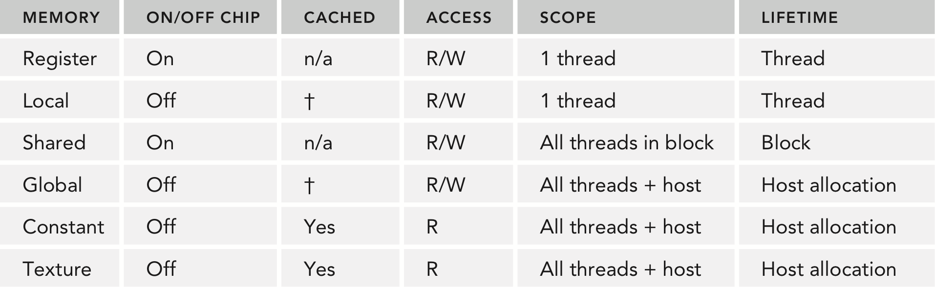
Review - CUDA Memory Spaces

Slide 96
CUDA Kernel Synchronization
Notes:
CUDA is a particular programming model for the NVIDIA hardware we just went over.

Slide 97
Kernel Synchronization
Synchronization in CUDA is closely tied with the CUDA memory hierarchy.
Relative to CPU programming models, synchronization options are constrained in CUDA.
CUDA is designed to be highly scalable and portable across generations
Lots of synchronization negates both of these principles
There is no global synchronization in CUDA (i.e. no #pragma omp barrier) – global synchronization requires kernel termination.
Instead, CUDA offers local synchronization and some global memory fences.
For performance reasons, use of these should still be minimized

Slide 98
Kernel Synchronization
Function | Action | Scope | Notes
__syncthreads() | Barrier | Thread block | Most commonly useful function.
__threadfence_block() | Memory fence | Thread block | Applies to shared and global mem.
__threadfence() | Memory fence | Device | Same as __threadfence_block(), but also a global memory write fence relative to all threads on the device.
__threadfence_system() | Memory fence | Whole system | Same as __threadfence_block(), but also a global memory write fence relative to all threads on the device and host and read fence for calling thread.

Slide 99
Review - Kernel Synchronization
Good chance you’ll only ever use __syncthreads()
Avoid synchronization at all costs.
Global synchronization by kernel termination.

Slide 100
Optimizing CUDA Memory Accesses
CPUs rely heavily on hardware-managed caches for performance.
GPU caching is a more challenging problem
Thousands of threads cooperating on a problem
Difficult to predict the next round of accesses for all threads
For efficient global memory access, GPUs instead rely on:
Large device memory bandwidth
Aligned and coalesced memory access patterns
Maintaining sufficient pending I/O operations to keep the memory bus saturated and hide global memory latency

Slide 101
Optimizing CUDA Memory Accesses
Aligned and coalesced global memory accesses are key to optimizing an application’s use of global memory bandwidth.
Coalesced: threads in a warp reference memory addresses that can all be serviced by a single global memory transaction (think of a memory transaction as the process of bring a cache line into the cache)
Aligned: the global memory accesses by threads within a warp start at an address boundary that is an even multiple of the size of a global memory transaction

Slide 102
Optimizing CUDA Memory Accesses
Global memory transactions are either 32 or 128 contiguous bytes.
Up to Maxwell, size of memory transaction depends on caches it passes through.
L1 + L2 - 128 bytes, L2 only - 32 bytes
With Maxwell/Pascal, all transactions are 32 bytes.
Information in the “Volta Tuning Guide” is sparse at this time, but expect similar behaviour to Pascal.
DRAM
32-byte transactions
L2 Cache
128-byte transactions
L1 Cache

Slide 103
Optimizing CUDA Memory Accesses
Which caches a global memory transaction passes through depends on GPU architecture and the type of access (read vs. write).
Architecture | Reads Cacheable in L1? | Cached by Default?
Fermi | Yes | Yes
Kepler | No | No
Kepler K40 + Maxwell | Yes | No
Pascal P100 | Yes | Yes
Pascal P104 | Yes | No
Volta | Yes | Yes
Global memory reads cached in L2 if not in L1
Architecture | Writes Cacheable in L1? | Cached by Default?
Fermi | No | No
Kepler | No | No
Kepler K40 through Volta | No | No
Volta | Yes | Yes
Global memory writes cached in L2, up until Volta.

Slide 104
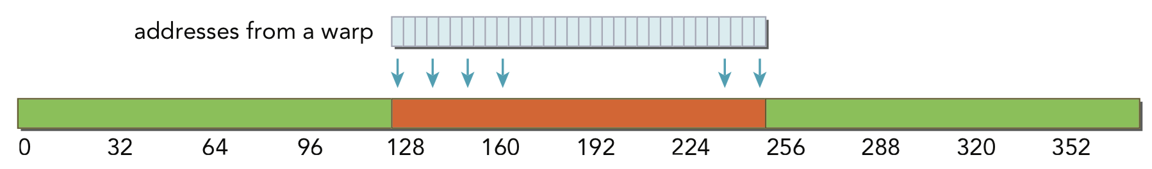
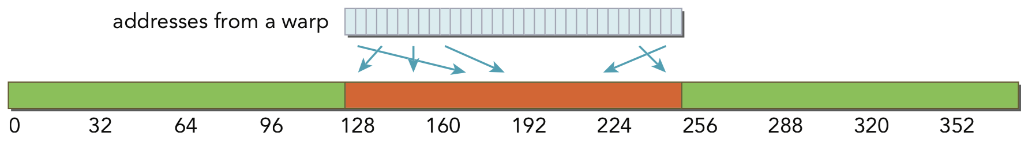
Optimizing CUDA Memory Accesses
Aligned and Coalesced Memory Access (w/ L1 cache)
With 128-byte transactions, a single transaction is required and all of the loaded bytes are used

Slide 105
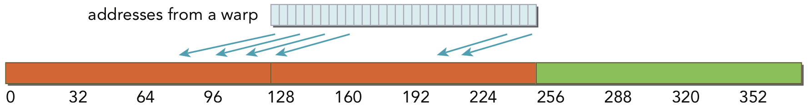
Optimizing CUDA Memory Accesses
Misaligned and Coalesced Memory Access (w/ L1 cache)
With 128-byte transactions, two memory transactions are required to load all requested bytes. Only half of the loaded bytes are used.

Slide 106
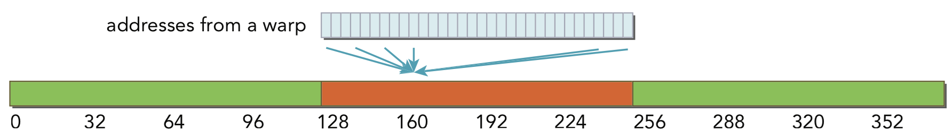
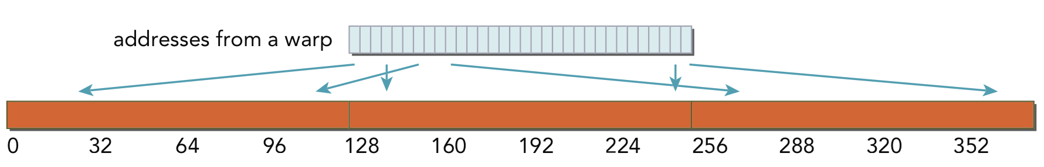
Optimizing CUDA Memory Accesses
Misaligned and Uncoalesced Memory Access (w/ L1 cache)
With uncoalesced loads, many more bytes loaded than requested.

Slide 107
Optimizing CUDA Memory Accesses
Memory accesses that are not cached in L1 are serviced by 32-byte transactions
This can improve memory bandwidth utilization
However, the L2 cache is device-wide, higher latency than L1, and still relatively small ➔ many applications may take a performance hit if L1 cache is not used for reads

Slide 108
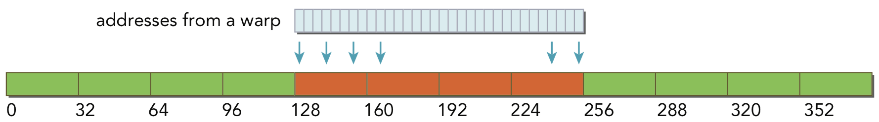
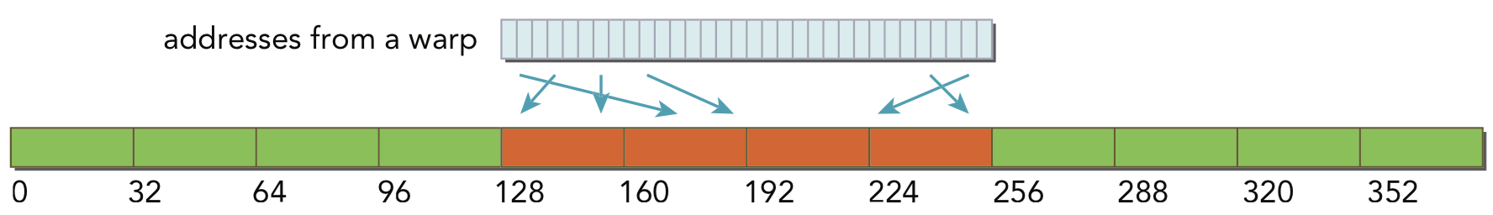
Optimizing CUDA Memory Accesses
Aligned and Coalesced Memory Access (w/o L1 cache)
With 32-byte transactions, four transactions are required and all of the loaded bytes are used

Slide 109
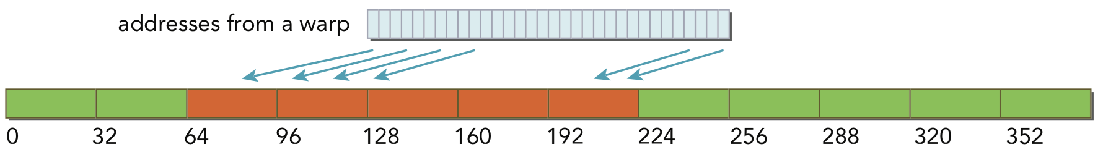
Optimizing CUDA Memory Accesses
Misaligned and Coalesced Memory Access (w/o L1 cache)
With 32-byte transactions, extra memory transactions are still required to load all requested bytes but the number of wasted bytes is likely reduced compared to 128-byte transactions.

Slide 110
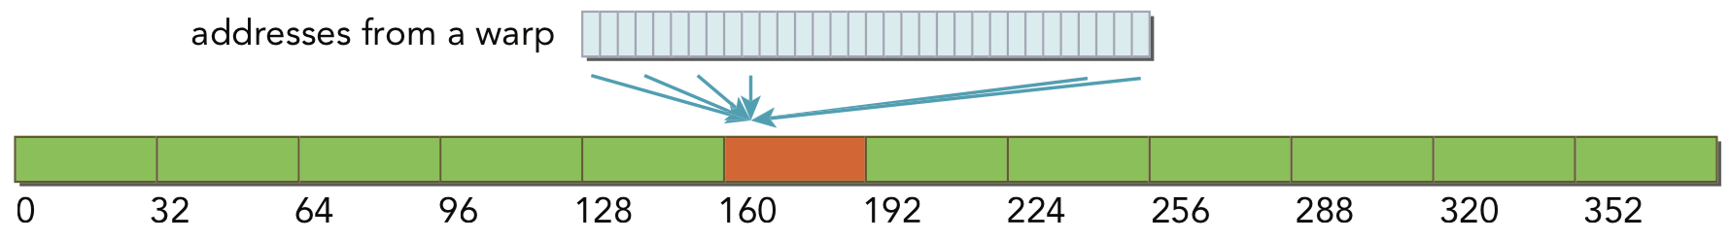
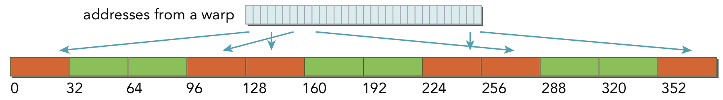
Optimizing CUDA Memory Accesses
Misaligned and Uncoalesced Memory Access (w/o L1 cache)
With uncoalesced loads, more bytes loaded than requested but better efficiency than with 128-byte transactions.
Notes:
Instructor Note: At this point, walk through the readSegment.cu example on pgs 165-168 in the book to demonstrate the actual performance implications of misaligned reads using nvprof.

Slide 111
Hands On – Memory Access Optimization
To illustrate these points, we’ll experiment with a variation on the vector add micro-benchmark under $HOME/bootcamp-gpu/src/03_vecadd_misaligned.
vector_add
vector_add_read_offset
vector_add_write_offset
vector_add_weirdly_coalesced
vector_add_not_coalesced
Notes:
Instructor Note: At this point, walk through the readSegment.cu example on pgs 165-168 in the book to demonstrate the actual performance implications of misaligned reads using nvprof.

Slide 112
Hands On – Memory Access Optimization
Experiment with several new metrics from nvprof:
gld_transactions: # of global memory load transactions
gst_transactions: # of global memory store transactions
gld_transactions_per_request: mean # of gld txs issued to satisfy a warp’s request
gst_transactions_per_request: mean # of gst txs issued to satisfy a warp’s request
gld_efficiency: gld_requests / gld_transactions
gst_efficiency: gst_requests / gst_transactions
$ nvprof --metrics gld_transactions ./vecadd 4194304
$ nvprof --metrics gst_transactions ./vecadd 4194304
$ ...
What do you observe?
Notes:
Instructor Note: At this point, walk through the readSegment.cu example on pgs 165-168 in the book to demonstrate the actual performance implications of misaligned reads using nvprof.

Slide 113
Hands On – Memory Access Optimization
Misaligned, uncoalesced reads ⬆ gld_transactions
Misaligned, uncoalesced reads
⬆ gld_transactions_per_request
Misaligned, uncoalesced reads ⬇ gld_efficiency
Misaligned, uncoalesced writes ⬆ gst_transactions
Misaligned, uncoalesced writes
⬆ gst_transactions_per_request
Misaligned, uncoalesced writes ⬇ gst_efficiency

Slide 114
Optimizing CUDA Memory Accesses
Kernel: vector_add(int*, int*, int*, int)
1 gld_transactions Global Load Transactions 267988 267988 267988
1 gst_transactions Global Store Transactions 134288 134288 134288
1 gld_transactions_per_request Global Load Transactions Per Request 1.022293 1.022293 1.022293
1 gst_transactions_per_request Global Store Transactions Per Request 1.024536 1.024536 1.024536
1 gld_efficiency Global Memory Load Efficiency 97.82% 97.82% 97.82%
1 gst_efficiency Global Memory Store Efficiency 100.00% 100.00% 100.00%
Kernel: vector_add_read_offset(int*, int*, int*, int, int)
1 gld_transactions Global Load Transactions 530593 530593 530593
1 gst_transactions Global Store Transactions 132440 132440 132440
1 gld_transactions_per_request Global Load Transactions Per Request 2.024052 2.024052 2.024052
1 gst_transactions_per_request Global Store Transactions Per Request 1.010437 1.010437 1.010437
1 gld_efficiency Global Memory Load Efficiency 49.41% 49.41% 49.41%
1 gst_efficiency Global Memory Store Efficiency 100.00% 100.00% 100.00%
Kernel: vector_add_write_offset(int*, int*, int*, int, int)
1 gld_transactions Global Load Transactions 264684 264684 264684
1 gst_transactions Global Store Transactions 265384 265384 265384
1 gld_transactions_per_request Global Load Transactions Per Request 1.009689 1.009689 1.009689
1 gst_transactions_per_request Global Store Transactions Per Request 2.024719 2.024719 2.024719
1 gld_efficiency Global Memory Load Efficiency 99.04% 99.04% 99.04%
1 gst_efficiency Global Memory Store Efficiency 80.00% 80.00% 80.00%
Kernel: vector_add_weirdly_coalesced(int*, int*, int*, int)
1 gld_transactions Global Load Transactions 264908 264908 264908
1 gst_transactions Global Store Transactions 132020 132020 132020
1 gld_transactions_per_request Global Load Transactions Per Request 1.010544 1.010544 1.010544
1 gst_transactions_per_request Global Store Transactions Per Request 1.007233 1.007233 1.007233
1 gld_efficiency Global Memory Load Efficiency 98.96% 98.96% 98.96%
1 gst_efficiency Global Memory Store Efficiency 200.00% 200.00% 200.00%
Kernel: vector_add_not_coalesced(int*, int*, int*, int)
1 gld_transactions Global Load Transactions 525168 525168 525168
1 gst_transactions Global Store Transactions 262360 262360 262360
1 gld_transactions_per_request Global Load Transactions Per Request 2.003357 2.003357 2.003357
1 gst_transactions_per_request Global Store Transactions Per Request 2.001648 2.001648 2.001648
1 gld_efficiency Global Memory Load Efficiency 49.92% 49.92% 49.92%
1 gst_efficiency Global Memory Store Efficiency 50.00% 50.00% 50.00%
Notes:
For 80% gst_efficiency of vector_add_write_offset = Stores only cached in L2 on Fermi -> 32-byte transactions -> 5 transactions for each warp’s requests of 128 bytes with offset=1

Slide 115
Review - Optimizing CUDA Memory Access
Seek aligned and coalesced global memory accesses when optimizing CUDA kernel performance.
The way in which a load/store is serviced depends on the cache(s) it passes through.
Aligned and coalesced accesses reduce the number of transactions necessary and the efficiency of each of those transactions (i.e. # bytes requested / # bytes loaded).
Notes:
Instructor Note: At this point, walk through the readSegment.cu example on pgs 165-168 in the book to demonstrate the actual performance implications of misaligned reads using nvprof.

Slide 116
CUDA Atomic Operations (Briefly)
Notes:
CUDA is a particular programming model for the NVIDIA hardware we just went over.

Slide 117
Atomic Operations
Atomic operations are a special class of mathematical operations in computing
An atomic operation is performed uninterruptedly, so that there is no interference from other threads
When a thread’s atomic operation has completed, it can be certain its requested changes have been made without interference from other threads
Atomic operations are particularly useful on the massively parallel GPU
Atomic operations may improve correctness, but can have a detrimental impact on performance
Out of thousands of threads, only one can succeed in accessing a shared variable
Atomicity requires reading and writing DRAM, no caching allowed

Slide 118
Atomic Operations
__global__ void sumAll(int *in_array, int N, int *out_scalar) {
int i = blockIdx.x * blockDim.x + threadIdx.x;
if (i < N) {
// out_scalar += out_array[i] would cause massive data race
atomicAdd(out_scalar, in_array[i]);
}
}

Slide 119
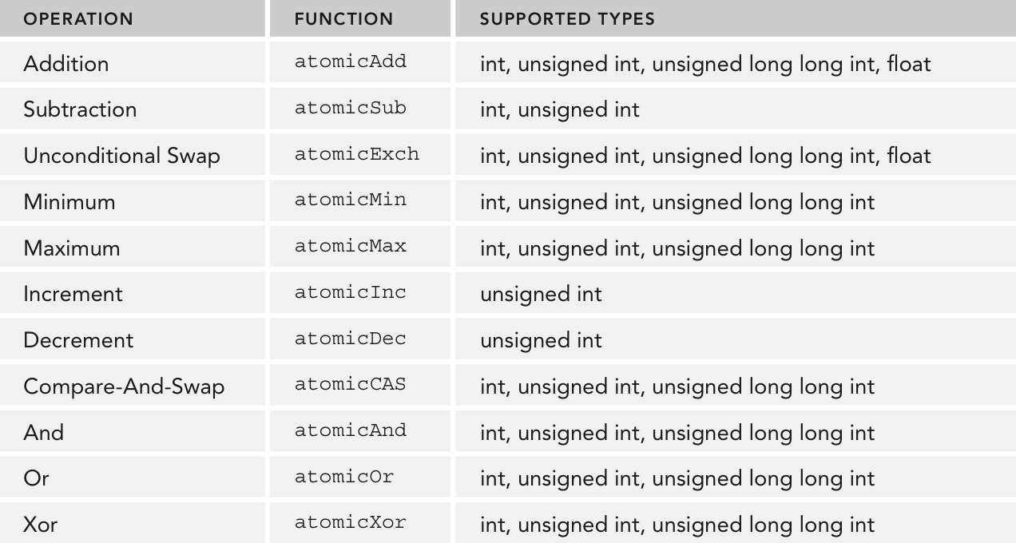
Atomic Operations Summary
CUDA supports a variety of atomic operations. CAS can be used to build your own.

Slide 120
Hands on with a Real World App
Notes:
CUDA is a particular programming model for the NVIDIA hardware we just went over.

Slide 121
A (Slightly) More Complex Application
2D wavefront propagation (stencil)
for (int y = 0; y < ny; y++) {
for (int x = 0; x < nx; x++) {
for (int d = 1; d <= radius; d++) {
div += c_coeff[d] * (curr[y_pos_offset] +
curr[y_neg_offset] + curr[x_pos_offset] +
curr[x_neg_offset]);
}
next[this_offset] = temp + div * vsq[this_offset];
}
}
We’ll use iso2d as a more realistic example to explore optimizations.

Slide 122
A More Complex Application
Provided reference code:
04_iso2d_seq/: sequential C implementation
$ cd $HOME/bootcamp-gpu/src/04_iso2d_seq
$ make
$ ./iso2d_seq –x 1024 –y 1024 –i 800 –t

Slide 123
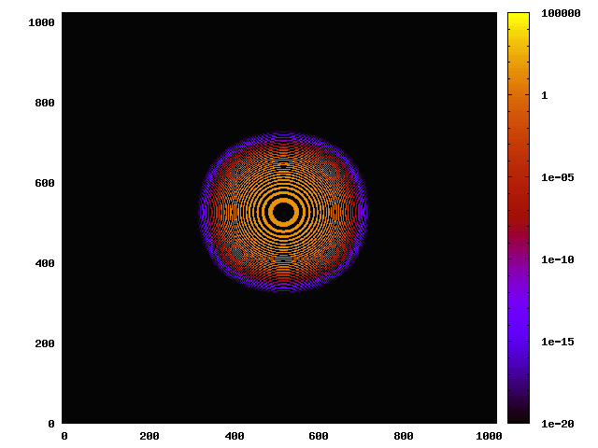
A More Complex Example
iso2d’s –t flag will produce an output file to visualize for correctness.
$ ../iso2d_common/iso.sh –x 1024 –y 1024 –i snap.text
$ eog iso.png # Must use ssh –X to connect to DAVINCI

Slide 124
Hands On – A Quick Review of OpenMP
Let’s start by examining the parallelism possible in iso2d using OpenMP.
Where could you add a #pragma omp parallel for in iso2d.cpp for the most parallelism?
Compare the performance of your OpenMP implementation to the provided sequential code by modifying iso2d.cpp in 04_iso2d_seq.
Visualize the results to verify the correctness of your OpenMP implementation.
$ ./iso2d_omp –x 1024 –y 1024 –i 800
(If you’re having trouble you can cheat and look in 05_iso2d_omp/)

Slide 125
Hands On – OpenMP to CUDA
Next, your task is to port the OpenMP version of iso2d to CUDA, and check its performance.
06_iso2d_cuda/iso2d.cu contains TODOs to help in the port.
Use nvprof’s Summary Mode to check where your implementation is spending time.
(If you’re having trouble you can cheat and look in iso2d_2dsolution.cu or iso2d_1dsolution.cu for solutions using 2D and 1D thread blocks)

Slide 126
Hands On – OpenMP to CUDA
Use nvprof’s Summary Mode to check where your implementation is spending time.
iso_r4_2x: 0.4557509422 s total, 0.0005638975 s/step, 1859.52 Mcells/s/step
==19313== Profiling application: ./iso2d_cuda_solution -x 1024 -y 1024 -i 800
==19313== Profiling result:
Time(%) Time Calls Avg Min Max Name
98.94% 432.51ms 800 540.64us 537.07us 546.56us fwd_kernel
0.85% 3.7121ms 804 4.6160us 1.2150us 955.81us [CUDA memcpy HtoD]
0.21% 911.11us 1 911.11us 911.11us 911.11us [CUDA memcpy DtoH]
==19313== API calls:
Time(%) Time Calls Avg Min Max Name
82.61% 444.60ms 805 552.29us 9.3120us 1.2511ms cudaMemcpy
15.56% 83.736ms 4 20.934ms 144.61us 83.285ms cudaMalloc
1.18% 6.3430ms 800 7.9280us 7.1660us 28.247us cudaLaunch
0.29% 1.5825ms 6400 247ns 207ns 8.7500us cudaSetupArgument

Slide 127
Hands On – OpenMP to CUDA
Dig deeper using nvprof metrics. We’ll start by just looking at the ones we’ve tried in past examples.
$ nvprof --metrics <metric> –x 1024 –y 1024 –i 800 –t with:
ipc
sm_efficiency
alu_fu_utilization
gld_transactions
gst_transactions
gld_transactions_per_request
gst_transactions_per_request
gld_efficiency
gst_efficiency

Slide 128
Hands On – OpenMP to CUDA
Dig deeper using nvprof metrics. We’ll start by just looking at the ones we’ve tried in past examples.
Invocations Metric Name Metric Description Avg
Device "Tesla M2050 (0)"
Kernel: fwd_kernel
800 sm_efficiency Multiprocessor Activity 99.92%
800 ipc Executed IPC 1.594381
800 gld_transactions Global Load Transactions 19710600
800 gst_transactions Global Store Transactions 1051120
800 gld_transactions_per_request Global Load Transactions Per Request 1.978683
800 gst_transactions_per_request Global Store Transactions Per Request 2.004852
800 gld_efficiency Global Memory Load Efficiency 50.71%
800 gst_efficiency Global Memory Store Efficiency 80.00%
800 alu_fu_utilization Arithmetic Function Unit Utilization High (7)

Slide 129
iso2d
What does this kernel load?
Accessed | Coalesced | Aligned? | Frequency of Access
curr[this_offset] | Yes | Maybe | A few threads
next[this_offset] | Yes | Maybe | A few threads
curr[y_pos_offset] | Yes | Maybe | A few threads
curr[y_neg_offset] | Yes | Maybe | A few threads
curr[x_pos_offset] | Yes | Maybe | A few threads
curr[x_neg_offset] | Yes | Maybe | A few threads
vsq[this_offset] | Yes | Maybe | A few threads
c_coeff[d] | No | Usually Not | All threads

Slide 130
iso2d
Constant memory is optimized for broadcast access (whole warp reads same location).
Variables in CUDA constant memory must be declared statically:
__constant__ TYPE const_c_coeff[NUM_COEFF];
Can be referenced as normal arrays from CUDA kernels:
const_c_coeff[d]
Initialized using a special-purpose cudaMemcpy API:
cudaMemcpyToSymbol(const_c_coeff, c_coeff, NUM_COEFF * sizeof(TYPE));

Slide 131
Hands On – Constant Memory
Try your hand at optimizing the iso2d CUDA version using constant memory.
Re-analyze the overall performance and the same profiler metrics.
A template with TODOs (along with an example solution) is available in 07_iso2d_cuda_cmem.

Slide 132
Hands On – Constant Memory
Try your hand at optimizing the iso2d CUDA version using constant memory.
Re-analyze the overall performance and the same profiler metrics.
Version | Performance (Mcells/s/step) | Improvement
Sequential | 73.35
OpenMP | 275.20 | 3.75
CUDA | 2,708.77 | 9.84
+ cmem | 2,812.53 | 1.04
-x 4096 -y 4096 -i 1000

Slide 133
Hands On – Constant Memory
Try your hand at optimizing the iso2d CUDA version using constant memory.
Re-analyze the overall performance and the same profiler metrics.
Invocations Metric Name Metric Description Avg
Device "Tesla M2050 (0)"
Kernel: fwd_kernel
800 sm_efficiency Multiprocessor Activity 99.90%
800 ipc Executed IPC 1.594887
800 gld_transactions Global Load Transactions 19714799
800 gst_transactions Global Store Transactions 1060304
800 gld_transactions_per_request Global Load Transactions Per Request 1.976322
800 gst_transactions_per_request Global Store Transactions Per Request 2.016384
800 gld_efficiency Global Memory Load Efficiency 50.60%
800 gst_efficiency Global Memory Store Efficiency 80.00%
800 alu_fu_utilization Arithmetic Function Unit Utilization High (7)
No significant change in metrics

Slide 134
Hands On – Constant Memory
Back to the drawing board.
Accessed | Coalesced | Aligned? | Frequency of Access
curr[this_offset] | Yes | Maybe | A few threads
next[this_offset] | Yes | Maybe | A few threads
curr[y_pos_offset] | Yes | Maybe | A few threads
curr[y_neg_offset] | Yes | Maybe | A few threads
curr[x_pos_offset] | Yes | Maybe | A few threads
curr[x_neg_offset] | Yes | Maybe | A few threads
vsq[this_offset] | Yes | Maybe | A few threads
c_coeff[d] | No | Usually Not | All threads

Slide 135
Hands On – Access Alignment
Depending on the width of the 2D grid we’re applying our stencil to, there may be many accesses that are mis-aligned.
32
(2 + 32 + 2) * sizeof(float) = 144 bytes per row
32
…
…
…
…
0
144
288
432
coalesced and aligned
coalesced and misaligned
coalesced and misaligned
coalesced and misaligned

Slide 136
Hands On – Access Alignment
Depending on the width of the 2D grid we’re applying our stencil to, there may be many accesses that are mis-aligned.
32
If we pad each row out to an even multiple of 128 bytes…
(2 + 32 + 2) * sizeof(float) + 112 = 256 bytes per row
32
…
…
…
…
0
256
512
640
coalesced and aligned
coalesced and aligned
coalesced and aligned
coalesced and aligned

Slide 137
Hands On – Access Alignment
Depending on the width of the 2D grid we’re applying our stencil to, there may be many accesses that are mis-aligned.
By padding rows in the grid to be a length evenly divisible by 128 bytes, we can improve the # of aligned accesses (thereby reducing transactions).
Try writing a version of your constant memory version of iso2d that pads all rows of curr, next, and vsq out to 128 bytes.
Re-analyze the overall performance and the same profiler metrics.
08_iso2d_cuda_aligned contains a starting template and example solution.

Slide 138
Hands On – Access Alignment
Version | Performance (Mcells/s/step) | Improvement
Sequential | 73.35
OpenMP | 275.20 | 3.75
CUDA | 2,708.77 | 9.84
+ cmem | 2,812.53 | 1.04
+ aligned | 2944.26 | 1.05
-x 4096 -y 4096 -i 1000

Slide 139
Hands On – Access Alignment
Metric | Old Value | New Value
sm_efficiency | 99.92% | 99.90%
ipc | 1.594381 | 1.717437
gld_transactions | 19710600 | 14179671
gst_transactions | 1051120 | 525216
gld_transactions_per_request | 1.978683 | 1.423451
gst_transactions_per_request | 2.004852 | 1.001770
gld_efficiency | 50.71% | 70.25%
gst_efficiency | 80.00% | 100.00%
alu_fu_utilization | High (7) | High (7)

Slide 140
Hands On – nvprof Throughput Metrics
Let’s collect some new metrics:
gld_throughput: Achieved throughput for global memory accesses
dram_read_throughput: Throughput between DRAM and L2
l2_read_throughput: Throughput through L2 cache

Slide 141
Hands On – nvprof Throughput Metrics
gld_throughput: Achieved throughput for global memory accesses
dram_read_throughput: Throughput between DRAM and L2
l2_read_throughput: Throughput through L2 cache
Kernel: fwd_kernel(float*, float*, float*, int, int, int, int)
gld_throughput Global Load Throughput 312.02GB/s
dram_read_throughput Device Memory Read Throughput 53.643GB/s
l2_read_throughput L2 Throughput (Reads) 125.45GB/s
Massive discrepancy?

Slide 142
iso2d
Throughput metrics suggest that we’re hitting a lot in L1 cache.
Can confirm using the l1_cache_global_hit_rate metric.
Metric Name Metric Description Avg
Device "Tesla M2050 (0)"
Kernel: fwd_kernel
l1_cache_global_hit_rate L1 Global Hit Rate 64.03%
Good: we’re getting lots of locality benefits.
Bad: L1 cache may be a bottleneck, losing some of our on-chip memory to shared memory.

Slide 143
iso2d
Original discussion of shared memory:
On-chip, low latency, high bandwidth
Same physical memory as L1 cache
Reconfigure the partitioning of on-chip memory between L1 and shared memory:
CUDA Grid
CUDA Thread Block
CUDA Threads/Warp
Registers
Local Memory
Shared Memory
L1 Cache
cudaError_t cudaThreadSetCacheConfig(
enum cudaFuncCache cacheConfig);
cudaFuncCachePreferNone (default)
cudaFuncCachePreferShared
cudaFuncCachePreferL1
L2 Cache
Global Memory
Constant Memory
Texture Memory

Slide 144
Hands On – On-Chip Memory Configuration
How does cudaThreadSetCacheConfig affect the performance of iso2d?
Try changing the call to it at the start of the 08_iso2d_cuda_aligned example solution (iso2d_aligned_solution.cu) to be either:
cudaThreadSetCacheConfig(cudaFuncCachePreferShared);
cudaThreadSetCacheConfig(cudaFuncCachePreferL1);
Then, measure any change in overall performance and L1 hit ratios.

Slide 145
Hands On – On-Chip Memory Configuration
Version | Performance (Mcells/s/step) | Improvement
Sequential | 73.35
OpenMP | 275.20 | 3.75
CUDA | 2,708.77 | 9.84
+ cmem | 2,812.53 | 1.04
+ aligned | 2944.26 | 1.05
+ cudaFuncCachePreferShared | 2943.11 | 1.00
+ cudaFuncCachePreferL1 | 3037.05 | 1.03
-x 4096 -y 4096 -i 1000
w/ cudaFuncCachePreferNone: 64.03% L1 Global Hit Rate
w/ cudaFuncCachePreferShared: 64.04% L1 Global Hit Rate
w/ cudaFuncCachePreferL1: 77.29% L1 Global Hit Rate

Slide 146
Hands On – On-Chip Memory Configuration
Appears to be improvement possible by increasing on-chip locality.
Time to look in to shared memory.
Version | Performance (Mcells/s/step) | Improvement
Sequential | 73.35
OpenMP | 275.20 | 3.75
CUDA | 2,708.77 | 9.84
+ cmem | 2,812.53 | 1.04
+ aligned | 2944.26 | 1.05
+ cudaFuncCachePreferShared | 2943.11 | 1.00
+ cudaFuncCachePreferL1 | 3037.05 | 1.03
-x 4096 -y 4096 -i 1000
w/ cudaFuncCachePreferNone: 64.03% L1 Global Hit Rate
w/ cudaFuncCachePreferShared: 64.04% L1 Global Hit Rate
w/ cudaFuncCachePreferL1: 77.29% L1 Global Hit Rate

Slide 147
CUDA Shared Memory
Shared memory is shared by threads in the same block.
On-SM memory
Shared memory can be allocated statically or dynamically
Statically Allocated Shared Memory
Size is fixed at compile-time
Can declare many statically allocated shared memory variables
Can be declared globally or inside a device function
Can be multi-dimensional
__shared__ int s_arr[256][256];

Slide 148
CUDA Shared Memory
Dynamically Allocated Shared Memory
Size in bytes is set at kernel launch with a third kernel launch configurable
Can only have one dynamically allocated shared memory array per kernel
Must be one-dimensional array
__global__ void kernel(...) { extern __shared__ int s_arr[];
...
}
kernel<<<nblocks, threads_per_block, shared_memory_bytes>>>(...);

Slide 149
CUDA Shared Memory
What is reused in iso2d? i.e. what can benefit from improved on-chip locality?
for (int d = 1; d <= radius; d++) {
int y_pos_offset = POINT_OFFSET(x, y + d, dimx, radius);
int y_neg_offset = POINT_OFFSET(x, y - d, dimx, radius);
int x_pos_offset = POINT_OFFSET(x + d, y, dimx, radius);
int x_neg_offset = POINT_OFFSET(x - d, y, dimx, radius);
div += const_c_coeff[d] * (curr[y_pos_offset] +
curr[y_neg_offset] + curr[x_pos_offset] +
curr[x_neg_offset]);
}

Slide 150
Hands On – Shared Memory
Take a look at using shared memory to tile curr. This is the toughest transformation we’ll try today.
There is also a template and example solution under 09_iso2d_cuda_smem/.
You can start by declaring a dynamic shared memory allocation in the kernel, and figuring out how large it needs to be from the launch:
extern __shared__ TYPE cache[];
fwd_kernel<<<..., SHAREDY(conf.radius) * SHAREDX(conf.radius) *
sizeof(TYPE)>>>(...);
Give it a shot!

Slide 151
Hands On – Shared Memory
Version | Performance (Mcells/s/step) | Improvement
Sequential | 73.35
OpenMP | 275.20 | 3.75
CUDA | 2,708.77 | 9.84
+ cmem | 2,812.53 | 1.04
+ aligned | 2944.26 | 1.05
+ cudaFuncCachePreferL1 | 3037.05 | 1.03
+ smem | 2063.41 | 0.68

Slide 152
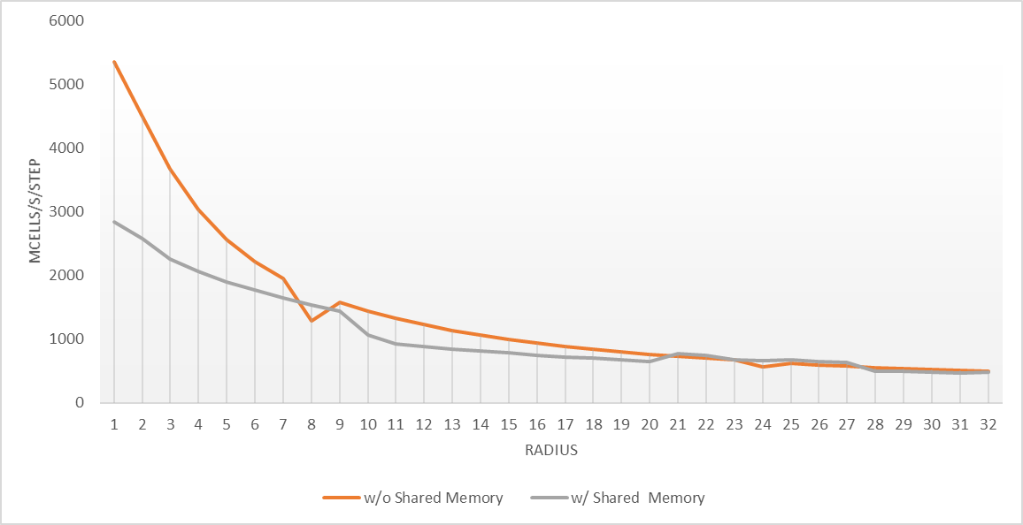
Hands On – Shared Memory
Increasing radius causes more reuse, more compute to offset overheads of cache initialization => w/ shared mem is better relative to w/o shared mem.

Slide 153
Hands On – Shared Memory
Very effective at reducing global load transactions.

Slide 154
Hands On – Shared Memory
Still don’t see any overall performance benefit because our manual management of shared memory is doing no better than the automatic management of L1, but incurs additional overheads (instructions executed, registers, etc).
Without shared memory, L1 Global Hit Rate = 77.29%
With shared memory, L1 Global Hit Rate = 0.13%

Slide 155
iso2d Summary
Version | Performance (Mcells/s/step) | Improvement
Sequential | 73.35
OpenMP | 275.20 | 3.75
CUDA | 2,708.77 | 9.84
+ cmem | 2,812.53 | 1.04
+ aligned | 2944.26 | 1.05
+ cudaFuncCachePreferL1 | 3037.05 | 1.03
+ smem | 2063.41 | 0.68

Slide 156
Alternatives to CUDA

Slide 157
OpenCL
A more open standard for parallel programming of a variety of processors.
Supports GPUs, CPUs, FPGAs
Much of the OpenCL API was based on the CUDA APIs:
CUDA API | OpenCL API
cudaMalloc | clCreateBuffer
cudaFree | clReleaseMemObject
cudaMemcpyAsync | clEnqueueWriteBuffer
cudaMemcpyAsync | clEnqueReadBuffer
kernel<<<...>>>(...); | clEnqueueNDRangeKernel
https://www.khronos.org/opencl/

Slide 158
OpenCL
Pros | Cons
Portable API, run one kernel everywhere. | More verbose, explicit API
Open source | Weaker tooling than CUDA
Not tied to a single vendor | Smaller community than CUDA, less established
Collaboration among many companies, constantly pushing the standard forward.
https://www.khronos.org/opencl/

Slide 159
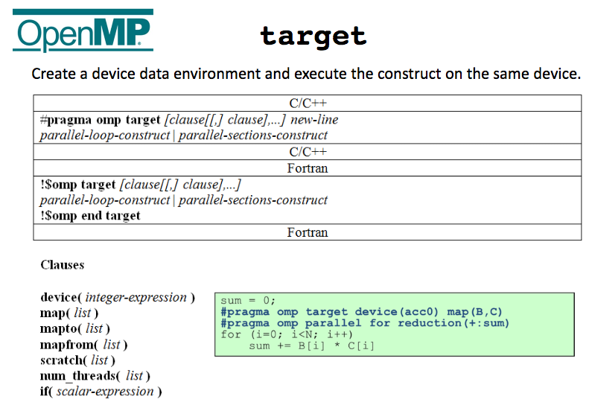
OpenMP Accelerators
http://openmp.org/wp/presos/SC12/Acc%20model%20for%20OpenMP%20BOF%20SC12%20v2.pdf

Slide 160
OpenMP Accelerators
Pros | Cons
High-level, easy to work with | Relatively new, implementations are still coming along, community is still growing, tooling is nonexistent
Supported by a large open-source consortium | Higher abstractions mean less control over optimizations
Single parallel programming model for host and device
http://openmp.org/wp/presos/SC12/Acc%20model%20for%20OpenMP%20BOF%20SC12%20v2.pdf

Slide 161
OpenACC
Pragma-based (ala OpenMP) programming for GPUs, primarily supported by PGI (a.k.a. NVIDIA).
#pragma acc parallel loop gang deviceptr(d_A, d_B, d_C)
for (i = 0; i < M; i++)
#pragma acc loop worker vector
for (j = 0; j < P; j++) {
float sum = 0.0f;
for (k = 0; k < N; k++)
sum += d_A[i * N + k] * d_B[k * P + j];
d_C[i * P + j] = sum;
}
http://www.openacc.org/

Slide 162
OpenACC
Pros | Cons
High-level, easy to work with | With OpenMP 4.0, future of OpenACC is unclear
Earliest example of pragma-based GPU programming, so likely the most stable | Higher abstractions mean less control over optimizations
Supported by NVIDIA/PGI
http://www.openacc.org/

Slide 163
Trilinos Project
“The Trilinos Project is an effort to develop algorithms and enabling technologies within an object-oriented software framework for the solution of large-scale, complex multi-physics engineering and scientific problems.”
Over 50 packages: https://trilinos.org/packages/
Includes packages for BLAS, Preconditioners, Linear Solvers, Nonlinear Solvers, Eigensolvers, Automatic Differentiation, Domain Decomposition, Partitioning, Mesh Manipulation, …
Supports CUDA, OpenMP as backends
Provided free and open source by Sandia National Lab
https://trilinos.org/

Slide 164
Trilinos Project
Pros | Cons
Like a super CUDA library | Long compile times due to heavy use of C++ templating
Open source and free, developed/supported by the national labs | Performance can be hit or miss
https://trilinos.org/

Slide 165
Kokkos, Raja
Kokkos (Sandia), Raja (Livermore)
C++ APIs that expose high-level parallel operators (e.g. map, reduce, parallel-for) and use template meta-programming to map them to multiple architectures
Emphasize that performance bottlenecks are predominantly in memory accesses
Kokkos sits under Trilinos library for computational science, used in production in industry and gov’t
Kokkos::parallel_for(numberOfAtoms,
[=] (const size_t atomIndex) {
atomForces[atomIndex] =
calculateForce(data);
}
);
double totalIntegral = 0;
Kokkos::parallel_reduce(numIntervals,
[=] (const size_t I,
double & valueToUpdate) {
valueToUpdate += function (...);
},
totalIntegral);
Example of parallel-for in Kokkos.
Blue shows Kokkos calls, red shows user-written kernel.
Example of parallel reduce in Kokkos.
Blue shows Kokkos calls, red shows user-written kernel

Slide 166
GPU Acceleration of the JVM
Many projects looking at JVM acceleration:
APARAPI: https://github.com/aparapi/aparapi
Rootbeer: https://github.com/pcpratts/rootbeer1
SWAT: https://github.com/agrippa/spark-swat
IBM’s J9 JVM: http://ahayashi.blogs.rice.edu/files/2013/07/IBM_Java8_GPU_PACT15_cameraready-sj0tik.pdf
Pros | Cons
Broader set of GPU applications | Overheads from JIT-ing, serialization, etc may make speedup harder to achieve
High-level JVM programming languages | Most solutions are still in the research stage
Speedup relative to JVM-based apps may be > speedup relative to native apps | Little or no control over optimization

Slide 167
Alternatives to GPUs

Slide 168
FPGA, KNL, x86
Is your hardware holding you back, or are you holding back your hardware?
GPUs have higher hardware peaks, but also have performance characteristics that you actually stand a chance of reasoning about.

Slide 169
Summary

Slide 170
Topics Not Covered
Multi-GPU CUDA Programming
CUDA-Aware MPI
Advanced Stream Usage
Advanced Instruction Optimization
Unified Memory
Texture Memory
Shared Bank Conflicts
CUDA libraries
Dynamic Parallelism
Warp Shuffle Instructions
cuda-gdb
…

Slide 171
Topics Covered
GPU Architecture
nvprof
CUDA Execution Model
Kernel Synchronization
CUDA Asynchrony
CUDA Memory Hierarchy
Optimizing CUDA Data Access
Hands On with a Non-Trivial CUDA
Application
CUDA Atomic Operations
Alternatives to CUDA

Slide 172
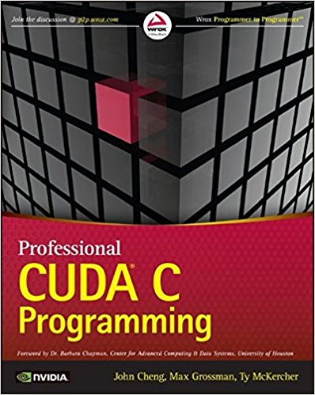
Additional Resources
I’m not condoning theft, but…
If you happen to google “Professional CUDA C Programming PDF”, the first result may or may not be a bootleg copy of my textbook, on which these slides are based.
Contact:
Max Grossman
max@7pod.tech

